Slide 1
A Fresh Approach to
High Performance and Accelerated Computing
Alan Edelman
David Sanders
Shashi Gowda
Ranjan Anantharam

Slide 2
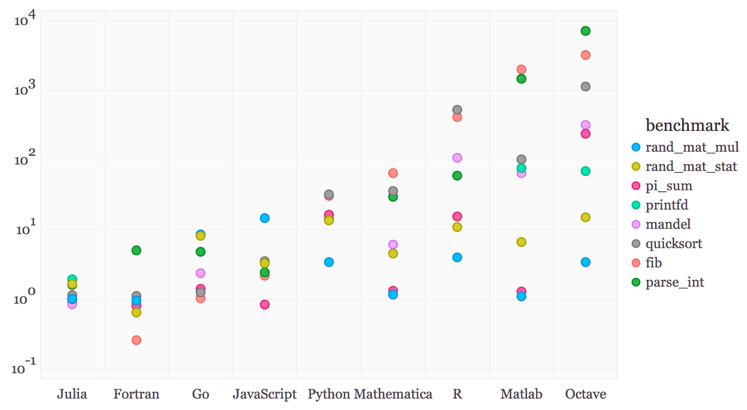

Designed for speed and ease of use
Benchmark times relative to C (smaller is better, C performance = 1.0).
Notes:
Julia people are performance obsessive
But it’s nost the only thing we obsess about
Interoperability and usability

Slide 3

Designed for Parallelism
Julia natively supports distributed parallelism via message passing
One sided communication with remote calls and fetches
Native multi-threading – parallel for loops, locks and atomics
Rich ecosystem for parallel computing
DistributedArrays.jl – work with distributed data with a convenient Array interface
MPI.jl for MPI- style message passing
ClusterManagers.jl – provides interfaces to a number of job-queue systems commonly used in compute clusters such as Sun Grid Engine and Slurm
Dagger.jl – a framework for parallel and out-of-core computations.
ArrayFire.jl – a library that supports heterogeneous computing

Slide 4

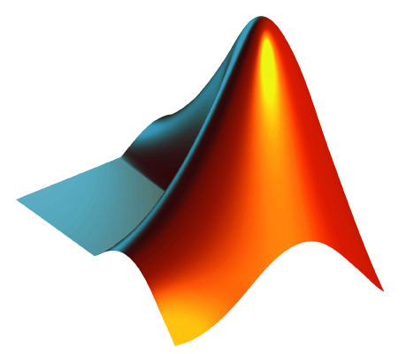





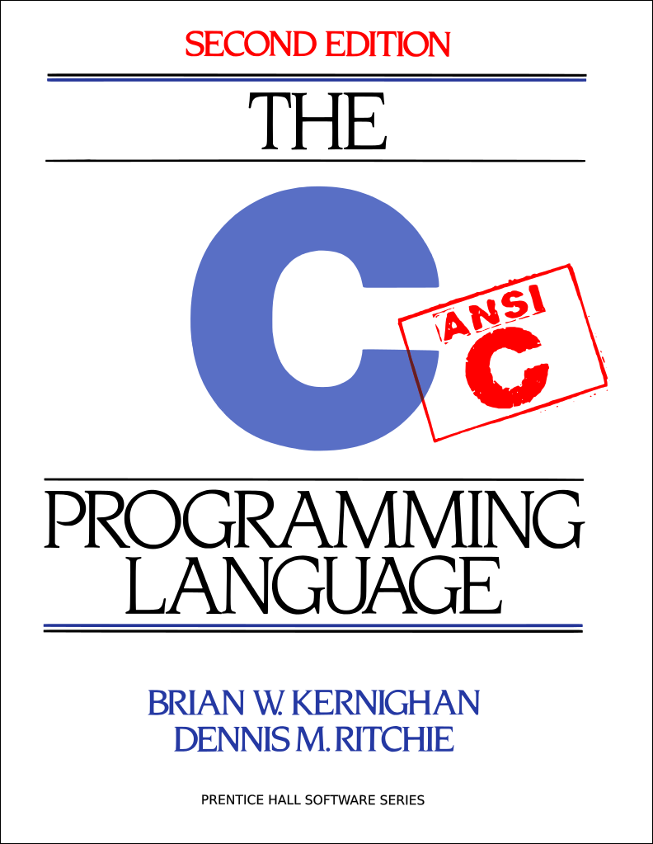
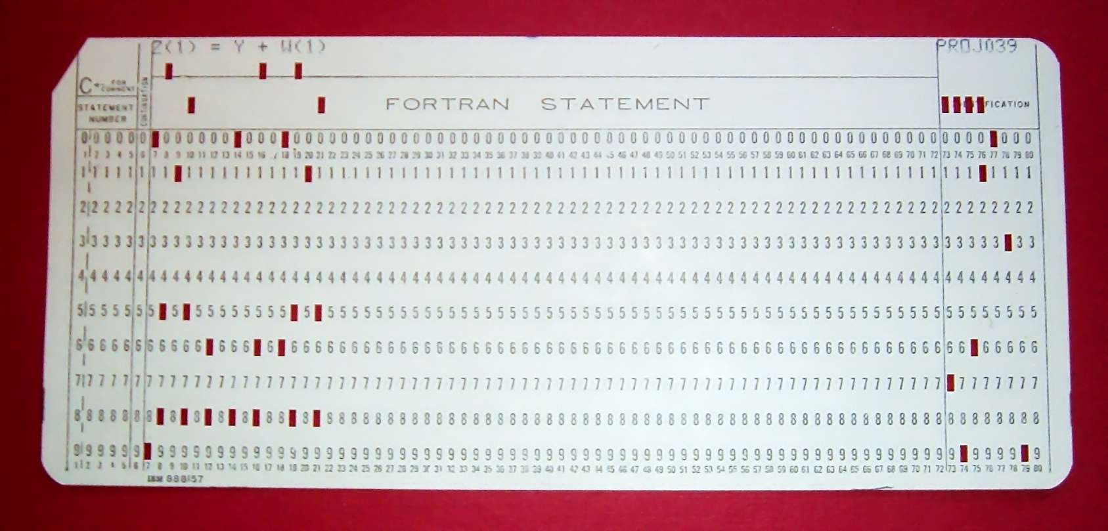
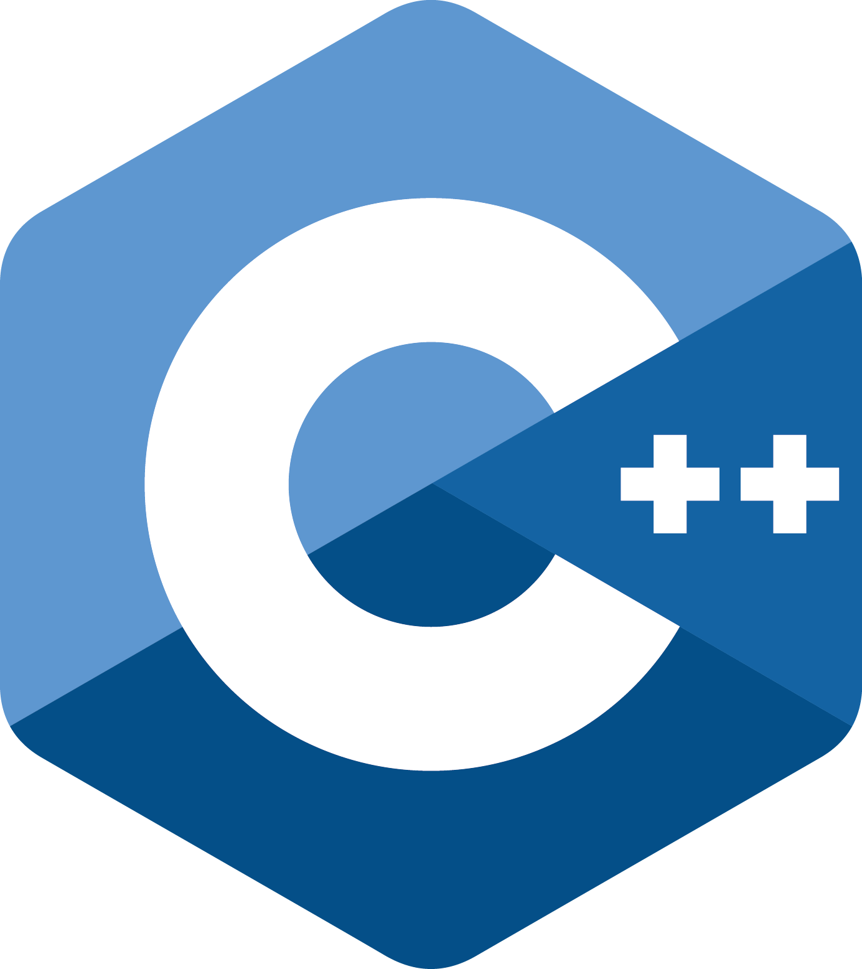

Technology and smarts inside:
Multiple Dispatch
Type System
Composable Constructions
Abstractions, etc.
Directly wired
To c-calls

Slide 5
Today’s toolsets are too difficult

Slide 6


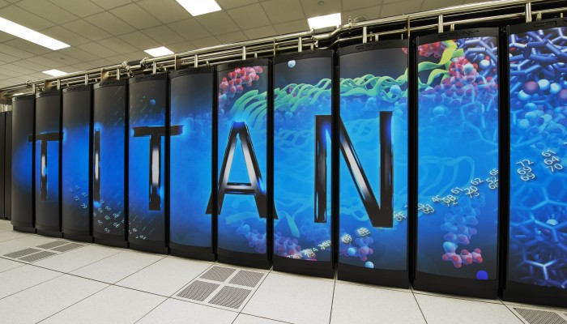




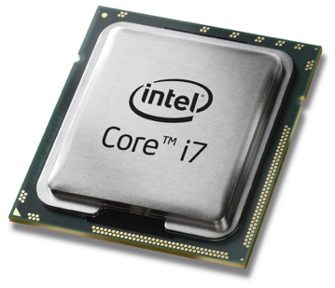
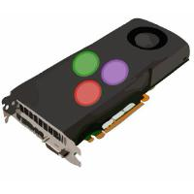

Users like to program in
High level languages on their own laptop
Any other toolset is a cognitive hurdle:
a chasm unlikely to be crossed.
This leaves performance and productivity on the table!

Slide 7
Modern Software Engineering

Slide 8
 | C/Fortran | Python/R/Matlab
Instruction Level Parallelism | The Compiler | (Libraries only) | Julia
GPU Computing | CUDA | Through Libraries | Julia
Multithreaded Computing | Threading Library | NA | Julia
Distributed/Cloud Computing | MPI | Some toolboxes | Julia
Asynchronous Concurrency | ?? | Some mechanisms (Python) | Julia

Slide 9

The Abstraction Dilemma
You expect to do You can imagine Special Purpose
Abstraction Category | Specificity increases Composability decreases Programmer Effort increases
Machine (what executes your program) | personal computer, laptop | distributed systems, shared-memory systems, GPUs | Application-Specific Integrated Circuits (e.g. bitcoin miner, AV interface, 3D printer)
Data (what is stored on the machine) | real numbers, arrays, strings | sparse arrays, symbolic expressions, graphs | special numbers ( intervals, dual numbers, quaternions), structured user-defined graphs
Functions/Algorithms/Applications (what you do with the data) | indexing, insertion/deletion, hashing, basic math (trig, arithmetic, etc.) Matrix factorization | automatic differentiation, symbolic solvers, special functions ( airy, bessel, etc.) Special sparse matrix algorithms | Graph analytics, path optimization, trend detection, encryption, finite element analysis, compiler design, probabilistic programs
JIT-compilation + Rich Type System
Efficient + Expressive Operator Overloading
The Solution:
Recover Composability
Decrease Programmer Effort

Slide 10
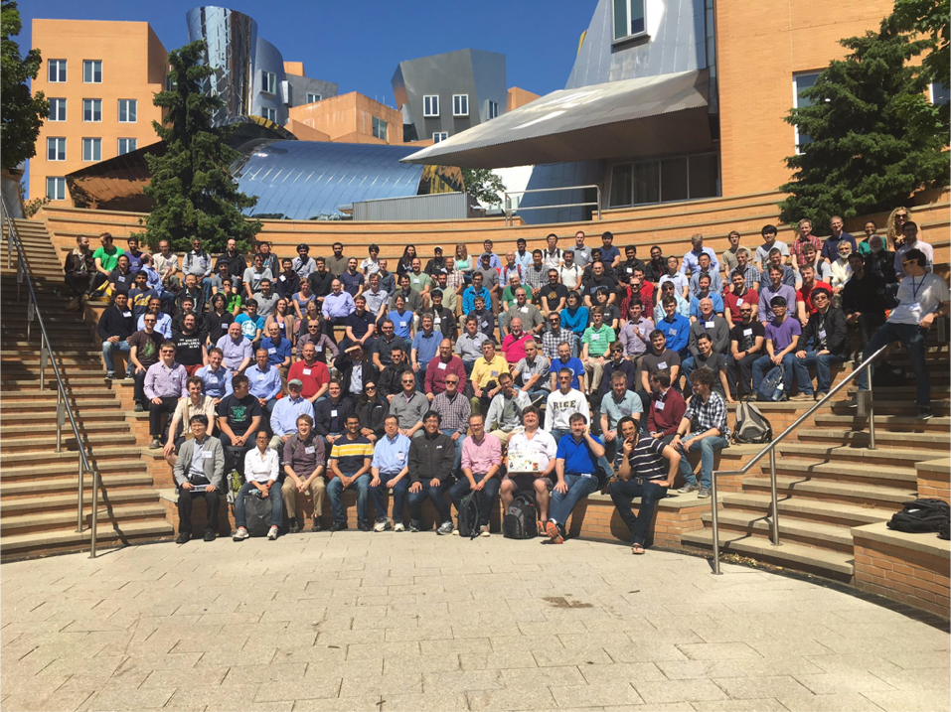
JuliaCon 2016: 50 talks and 250 attendees

Slide 11
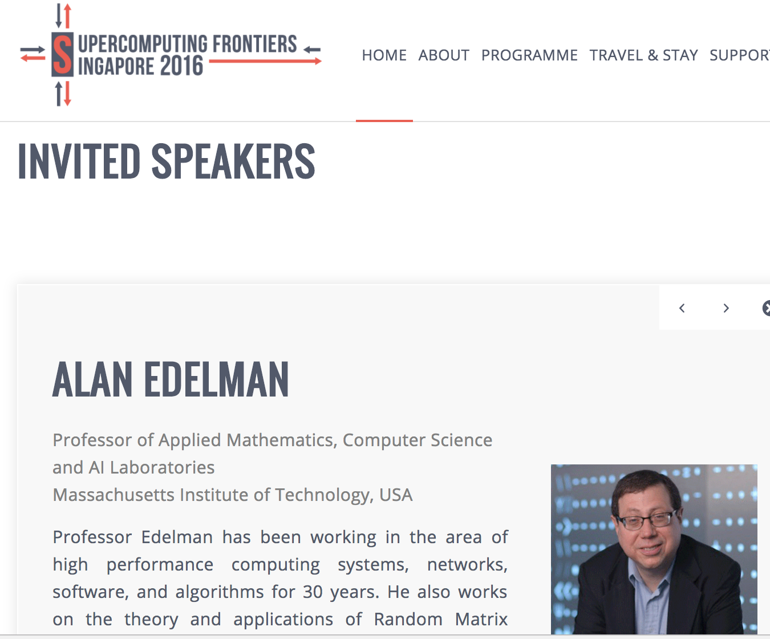

Julia in Singapore
Data Meetup Suntec City March 2016

Slide 12

Those who convert ideas to products fastest will win
Typical Workflow in the last 25 years
Develop Algorithms
(Python, R, SAS, Matlab)
Rewrite in a systems language
(C++, C#, Java)
Deploy
Compress the innovation cycle with Julia
Develop Algorithms
(Julia)
Deploy

Slide 13
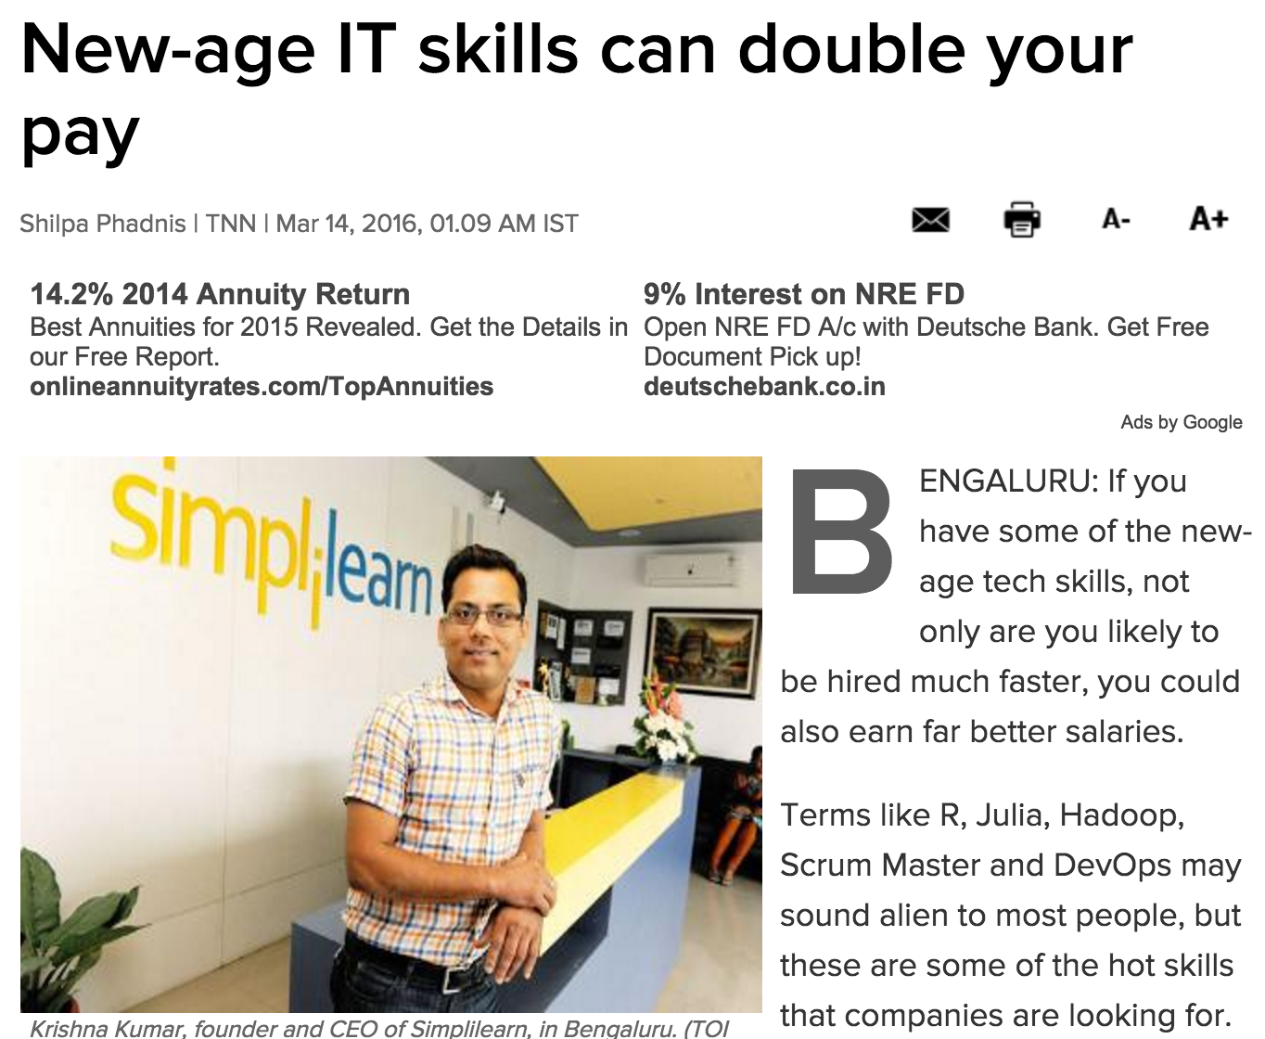
Notes:
J

Slide 14
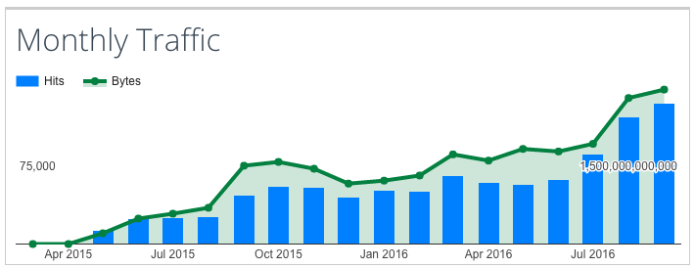
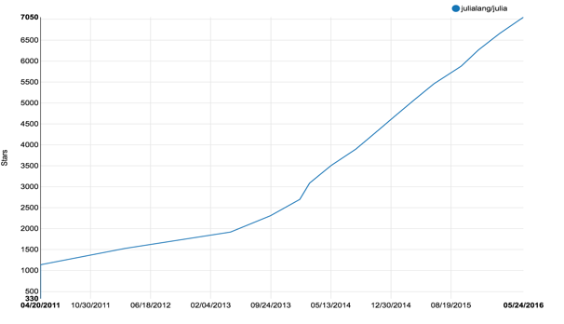
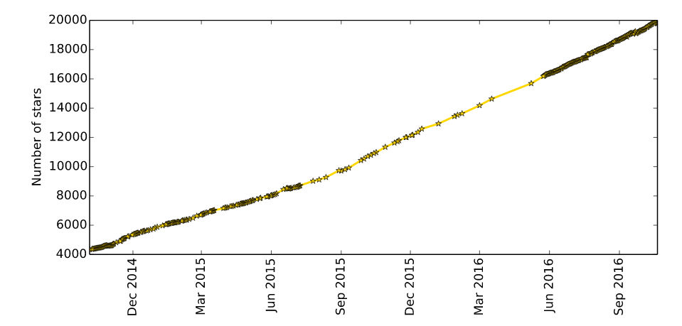
The user base is doubling every 9 months
Julia Community
150,000 users
Github (Julia)
500 contributors
7,700 stars
Website 2,000,000 visitors YouTube 200,000 views
JuliaCon 800 attendees
Julia Packages
1,100 packages
20,000 Github stars

Slide 15
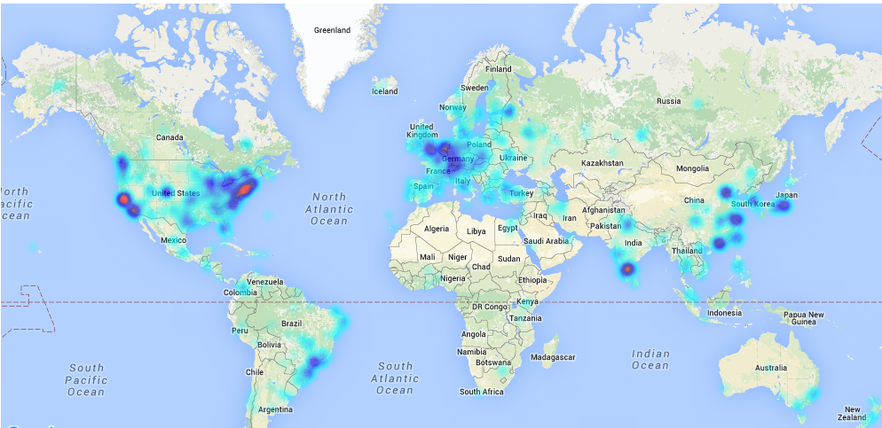
The Julia community: 150,000 users
Expecting to reach 1 million users and 10,000 enterprises by 2019
Research anchored at MIT

Slide 16












A few of the organizations using Julia

Slide 17


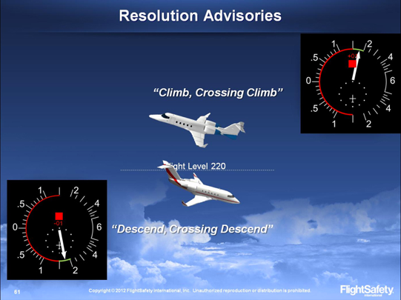


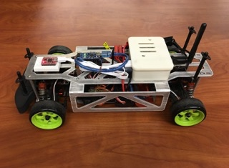
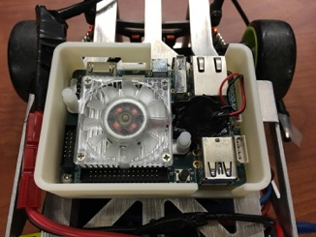
Traction across industries
Finance: Economic Models at the NY Fed | Engineering: Air Collision Avoidance for FAA
Retail: Modeling Healthcare Demand | IoT: Self-driving Cars at UC Berkeley

Slide 18
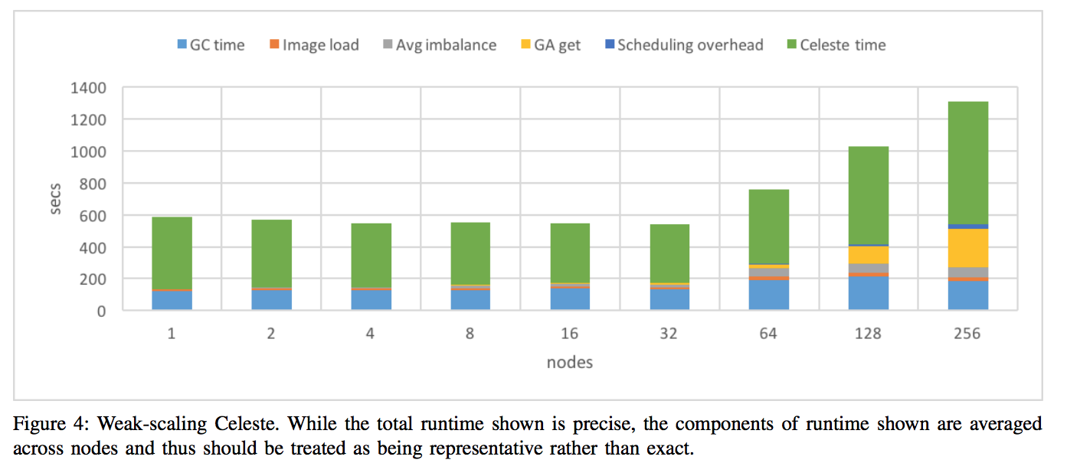
CASE STUDY
Celeste: Julia on 8,192 CPUs
Native Julia implementation of variational inference on a complex bayesian model
Learning an astronomical catalog of the visible universe through scalable Bayesian inference
Collaboration between LBNL, Julia Computing, Intel and JuliaLabs@MIT
Huge scaling on the NECSRC Cori Supercomputer on 8192 Intel Xeon® cores
Uses Julia’s multi-threading and multi-processing capabilities

Slide 19

With Celeste . . . we’ve demonstrated excellent efficiency using hybrid parallelism (in Julia)—not just processes, but threads as well—something that’s still impossible to do with Python or R.
Pradeep Dubey, Intel Fellow

Slide 20
“If you have a choice of several languages, it is, all other things being equal, a mistake to program in anything but the most powerful one”. - Paul Graham in Beating the Averages Co-Founder, Y-Combinator

